Slide 1
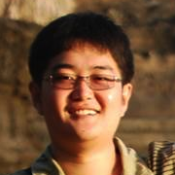
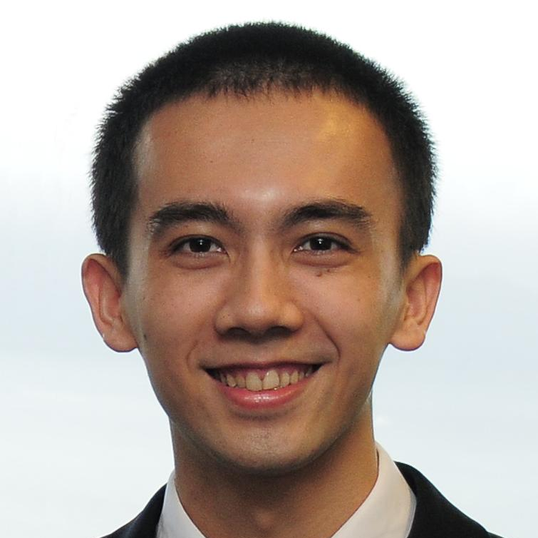
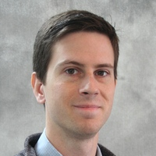
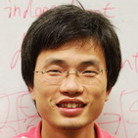
FrameBreak Dramatic Image Extrapolation by Guided Shift-Maps
Yinda Zhang
Jianxiong Xiao
James Hays
Ping Tan
Notes:
Hello, I am Jianxiong from MIT. This is a joint work with another 3 very cool guys from NUS and Brown.

Slide 2
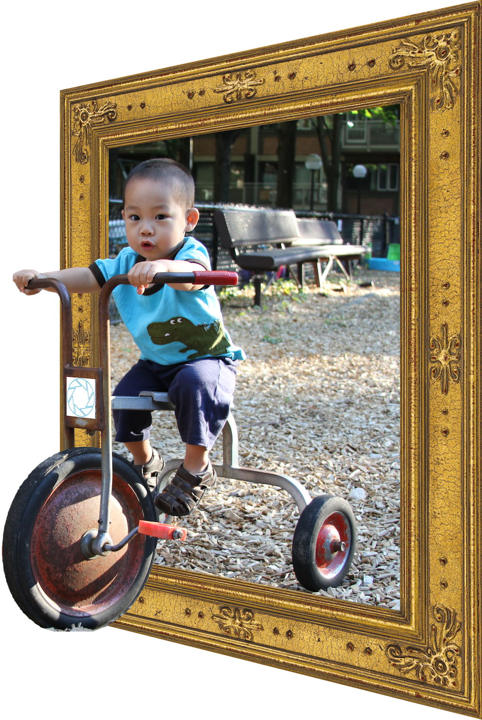
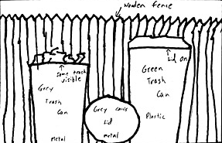
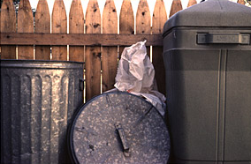
FrameBreak
Dad, show my picture, and I will let you go ICCP on weekend.
I wanna go outside!
Boundary Extension
Intraub and Richardson, 1989.
Notes:
For human vision, if you show someone a picture, and then hide it and ask them to draw the picture. The drawing is usually bigger than the picture.
For computer vision, we want to the computer to do the same.
For example, it would be cool to break the picture frame and go outside the available field of view.
Of course, this is not the only reason that my son's picture is shown here.

Slide 3
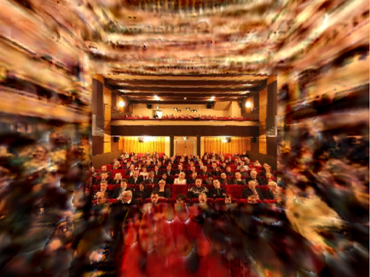
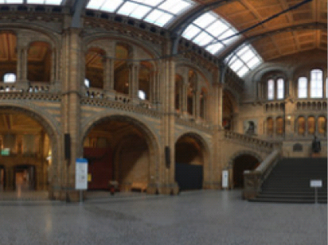
FrameBreak
Zhang, Xiao, Hays & Tan, CVPR 2013.
http://mit.edu/jxiao/framebreak/
Input Photo
Output Panorama
Guide Panorama
Recognizing Scene Viewpoint using Panoramic Place Representation. Xiao et al, CVPR 2012.
Notes:
Last year, we propose a parametric approach. But it is not beautiful enough for ICCP.
This year, we proposed a much better non-parametric approach.
Given a picture and the guild, our algorithm discover the transferable structure from the guild, and then automatically extrapolate the outside area of the image.
For more information, please come to our poster. Thanks!

